Slide 1
Putting Into Practice the Skills You’ve Learned Contributing to Kubernetes
@kiran_oliver #KubeCon #CloudNativeCon

Slide 2


Hello!
I’m Rin Oliver (pronouns: they/he). I’m a nonbinary, multiply neurodivergent Technical Community Builder at Camunda. You can find me on Twitter at @kiran_oliver or on GitHub @celanthe.

Slide 3
1. So you’re an open source contributor. Now what?
Let’s talk about how you can apply your knowledge to level up your life
@kiran_oliver #KubeCon #CloudNativeCon

Slide 4
You matter.
Your presence is impactful, and appreciated.
@kiran_oliver #KubeCon #CloudNativeCon

Slide 5
Some things to remember:
You know more than you think you do
Use it to your advantage
You are worth it
@kiran_oliver #KubeCon #CloudNativeCon
Notes:
Documentation, technical writing
Content creation, community building
DevSecOps
CI/CD, cloud-native security
Incident troubleshooting, bug fixes, flaky test hunting
Collaboration, teamwork, and communication
Responding to pull requests, reviewing issues, participating in SIGs

Slide 6
Hi, I’m new.
Switching careers? Just getting started? Not to worry. Your open source contributions can help you shine!
@kiran_oliver #KubeCon #CloudNativeCon

Slide 7
Creating your own greatness
Collaboration
Are you in the Kubernetes Slack? That’s where the fun is!
SIG meetings
Reviewing pull requests
Issue triage
Community
Put yourself out there
Create content in your own voice
Submit to CFPs. Need help? Ask!
Become a KubeCon Pod mentor or a mentee. (This Friday!)
@kiran_oliver #KubeCon #CloudNativeCon

Slide 8
Unify, teach, and inspire
Ecosystems
Share your expertise
Connect with others
Make progress towards a common goal
Celebrate wins
Communication
Not everyone communicates in the same way
Pause and think
Remember to breathe
Success
Ask: What does success mean to me?
Try not to compare yourself to others
Negotiate. Titles matter.
@kiran_oliver #KubeCon #CloudNativeCon

Slide 9
Progress is not linear. Trust me.
2019 - Lost job, paused major Kubernetes OSS work
2021 -- Got an amazing new job, and now I’m here with everyone at KubeCon!!
Remember: You don’t have to be perfect. You just have to keep going.
1
3
5
2
4
6
2020 - Back at it! Won the Kubernetes Contributor Summit Bake Off!!
Looking back is helpful to remember where you’ve been, but looking ahead helps too
2022 - Where will your future take you? How will you use what you’ve learned here today?
@kiran_oliver #KubeCon #CloudNativeCon

Slide 10
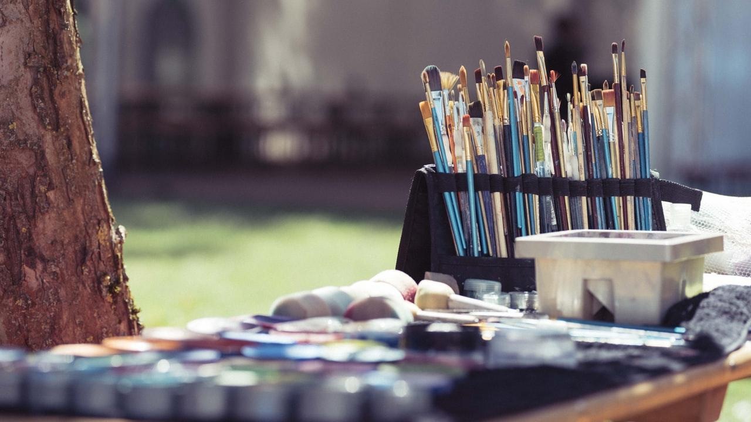
You’ve built some amazing things
Whether that’s writing docs, reviewing code, pushing new PRs, or participating in a SIG. You have created, and will continue to create, wonderful things that bring our community together.
@kiran_oliver #KubeCon #CloudNativeCon

Slide 11
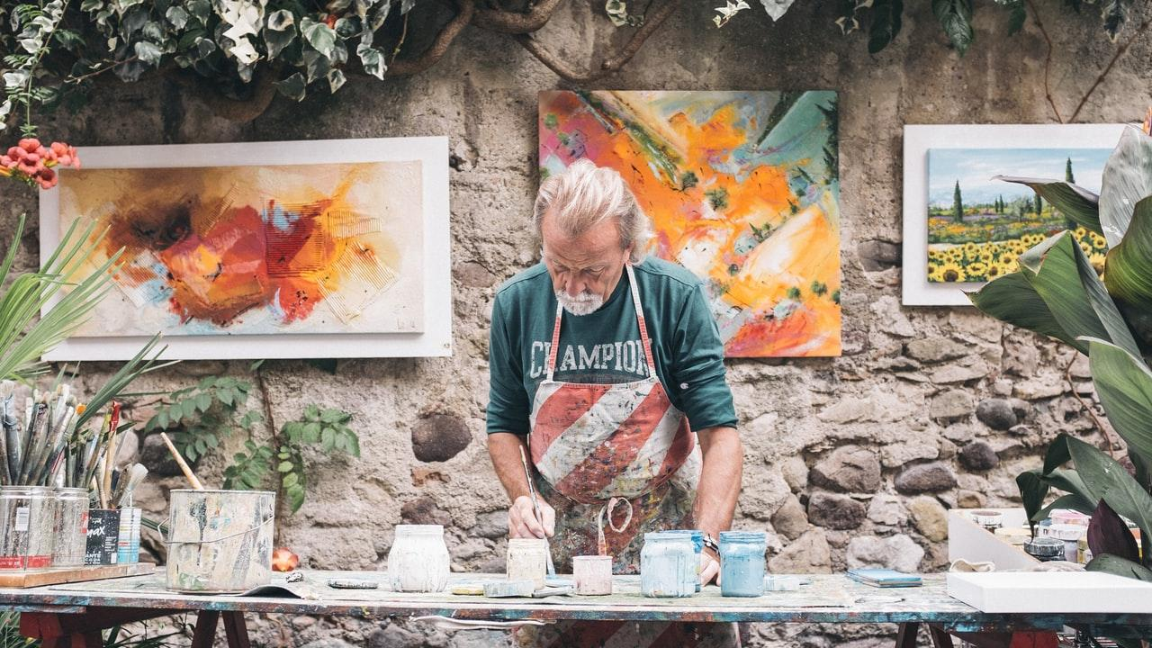
Now, it’s time to show them to the world.
Show yourself to the world. You are so worth knowing.
@kiran_oliver #KubeCon #CloudNativeCon

Slide 12
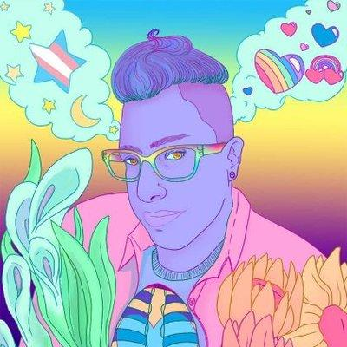
Thanks!
Any questions? You can find me at @kiran_oliver on Twitter & @celanthe on GitHub!
@kiran_oliver #KubeCon #CloudNativeCon

Slide 13
Credits
Special thanks to all the people who made and released these awesome resources for free:
Presentation template by SlidesCarnival
Photographs by Unsplash
Closing slide illustrated portrait by @o_zabethy

